Slide 1
The 7 Elements of Graphic Design

Slide 2
Have you even looked at a seemingly simple design and thought: I could totally do that.
But later, when you sit down to actually give it a whirl, you don't know why your attempt doesn't measure up to the professional version. What gives?

Slide 3
7 Basic Elements of Graphic Design
Color
Line
Scale
Shape
Alignment
Contrast
Space

Slide 4
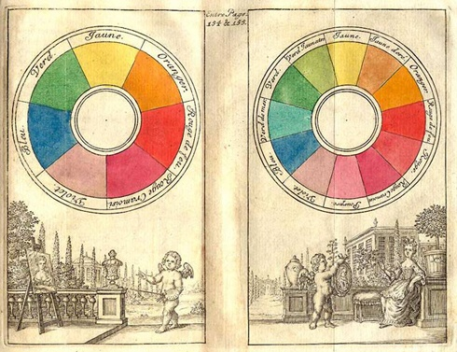
Color
Sir Isaac Newton is widely credited with creating the very first color wheel back in 1706. This 1708 version was illustrated by the French painter, Claude Boutet.

Slide 5
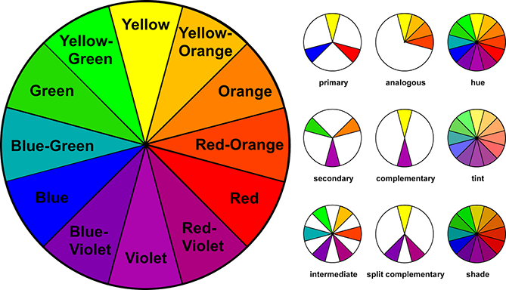
Color wheel
Newton's visual categorization system for color was adopted and expanded upon by scientists, artists, and philosophers over the years, eventually resulting in the modern color wheel we all know today.

Slide 6
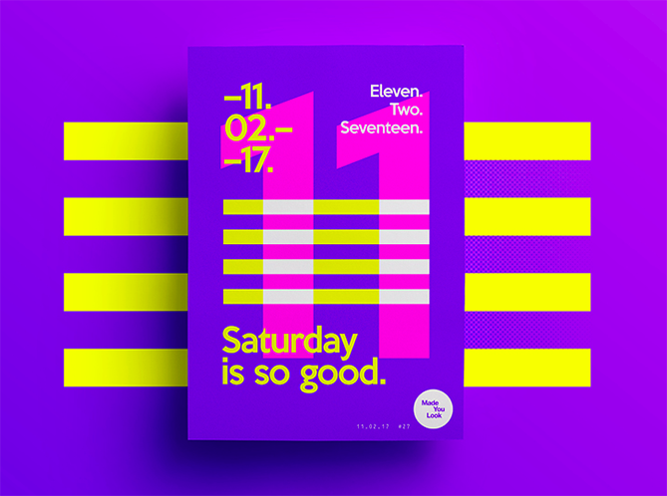
Color in Action:
This example from is a great example of complimentary colors in action. Violet and yellow, which appear directly opposite on the modern color wheel, produce a bold, visually appealing effect when paired together.

Slide 7
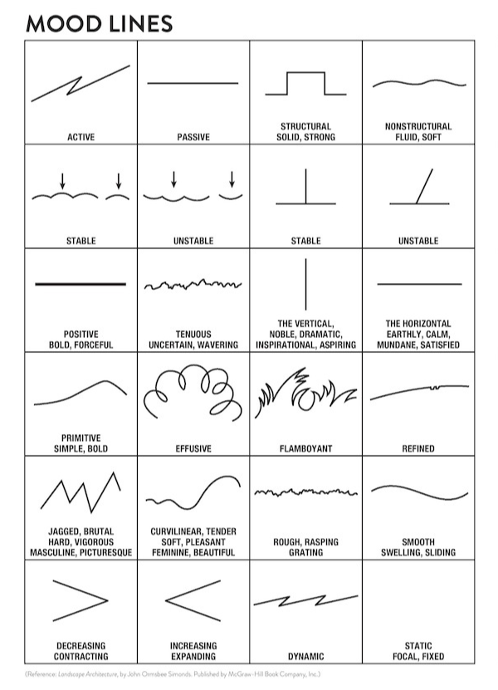
line
Lines are more than just dividers -- the right lines can convey movement and emotion, tying together your composition and making it looked polished and professional.

Slide 8
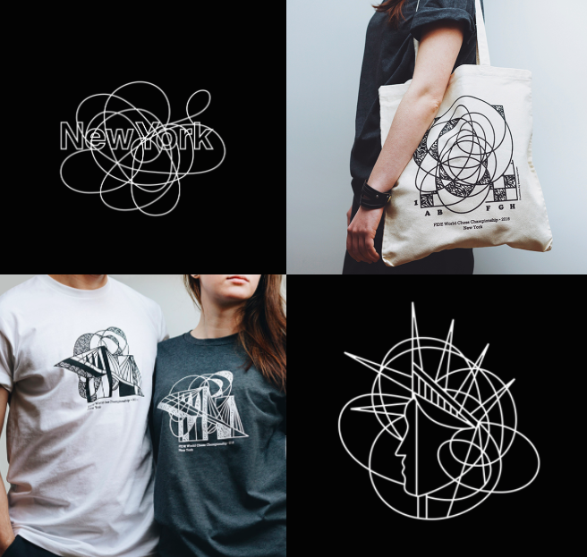
Line in Action

Slide 9

Scale
Playing with the relative size of different components in your design allows you to set a focal point, highlight areas of importance, and ultimately guide viewers' eyes through the piece.

Slide 10
Scale
Scale isn't quite the same thing as size. Size refers to an absolute measurement (e.g., the sheet of paper 8'' by 11'') while scale refers to the direct relationship between elements in a design (e.g., the circle is twice as big as the square).

Slide 11
Scale
You can use scale to create a visual hierarchy for your design. When an element is displayed at a relatively larger scale than the other elements in a composition, our eyes are naturally drawn to it.

Slide 12
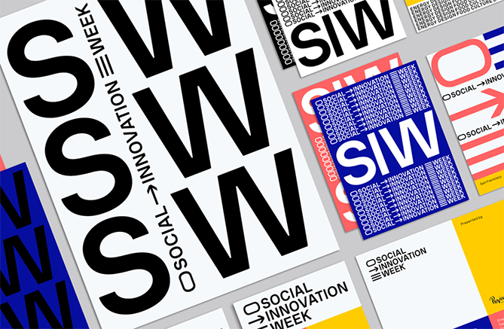
Scale in Action
To create a sense of drama and importance, New York-based graphic designer uses a high-contrast scale between elements in these promotional materials for San Francisco's Social Innovation Week.

Slide 13
Shape
Shapes: they're not just for preschoolers! A shape can be loosely explained as anything defined by boundaries. There are two categories of shapes to consider:

Slide 14
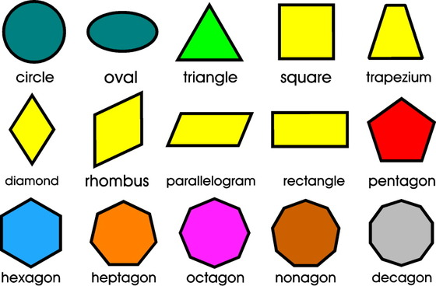
Shape
Geometric shapes, which are defined by perfect, uniform proportions (such as a circle, square, triangle), and organic shapes, which have less well-defined edges, free-flowing proportions, and essentially no rules (such as wiggly, blob-like things that don't fit into any real category).

Slide 15
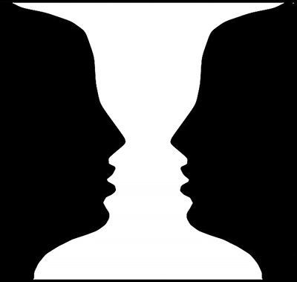
Shape
When working on a design, consider both the shapes you're deliberately incorporating (the positive shapes), and the shapes naturally formed around those shapes (the negative shapes).

Slide 16

Shape in Action
The humble circle has always been a popular, trusty way to display information in a clean, unified composition. Sydney-based Made Somewhere developed this simple, modern logo for Hidden Gems of Sydney, a blog focused on highlighting local attractions in the area.

Slide 17
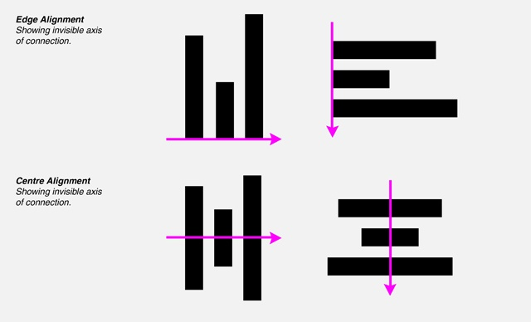
Alignment
Think of alignment like an invisible axis that runs between elements, connecting them visually either by their edges or centers.

Slide 18
Alignment
Alignment most frequently comes up in design discussions about text and typography, but it's equally important to consider the alignment of non-text elements when building a balanced, orderly composition.

Slide 19
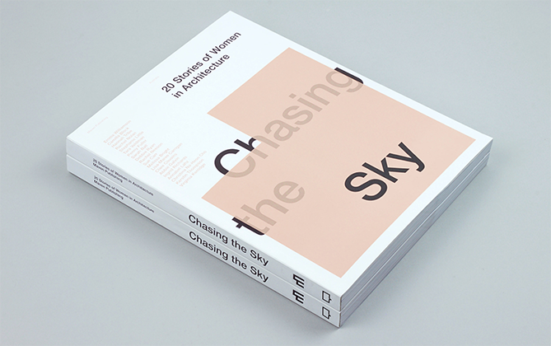
Alignment in Action
This is a book that honors the careers of influential female architects. The title typography is aligned around a geometric shape.

Slide 20
Contrast
Contrast refers to the juxtaposition of elements that strongly differ (big vs. small, light vs. dark, etc.) to create visual interest or draw attention to particular elements.

Slide 21
Contrast
Without contrast, our designs aren't just lackluster and boring to look at, they're also difficult to understand. A lack of contrast is often what separates mediocre design work from designs that look professional, polished, and clear.

Slide 22

Contrast

Slide 23
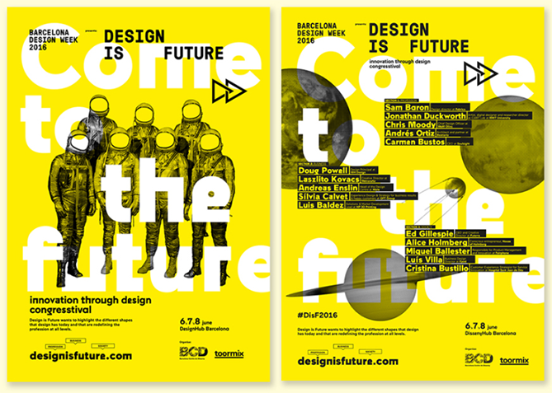
Contrast in Action:
The team at Barcelona-based toormix expertly plays with varying contrasts in this poster design for Barcelona Design Week 2016.

Slide 24
Space
Space is exactly what it sounds like: the empty areas between elements in your design. When it comes to creating professional-looking designs on your own, sometimes what you don't include is just as important as what you do.

Slide 25
Space
When working on a design, consider not only the elements you're including (such as images and text) but how they're arranged and grouped in the composition. It can be tempting to fill every inch of your digital canvas with something, but try to give your elements some room to breathe.

Slide 26
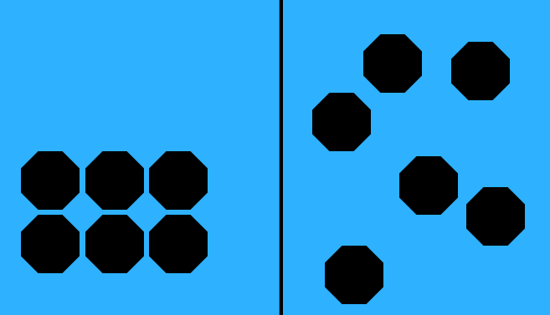
Space
In the example, you can see how changing the space and grouping of the elements creates a completely different feeling in the composition.

Slide 27
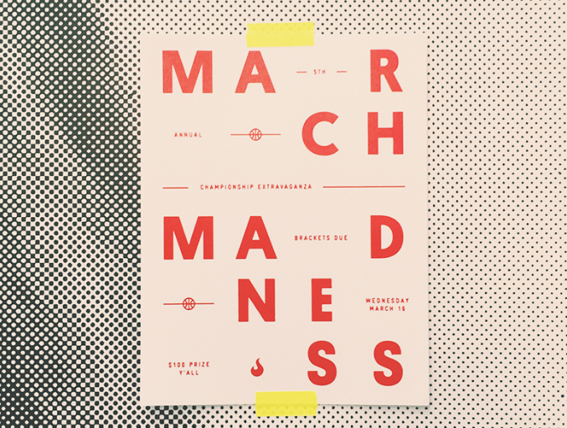
Space in Action
In this poster the text "March Madness" is displayed with unconventional spacing, adding some unexpected visual interest to an otherwise minimal design.

